Slide 1

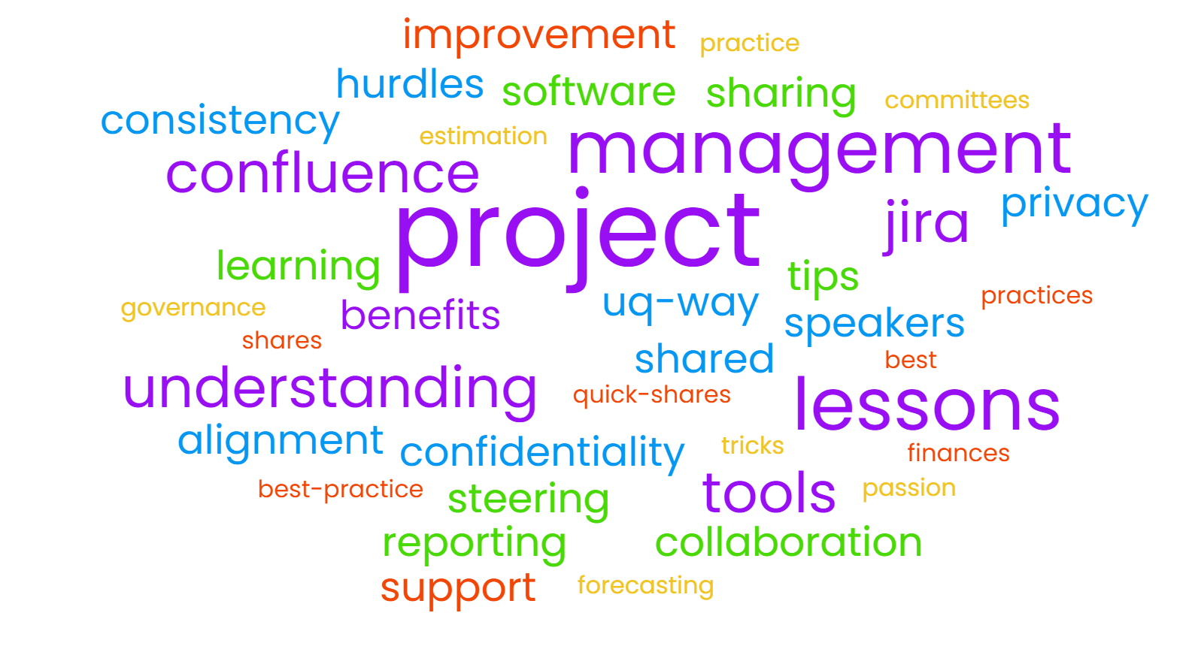
Project Management Community of Practice (PM CoP)
A welcoming space to share and grow your project management practice within the UQ context
2025 Meetings
2 Apr | 28 May | 30 July | 27 Aug | 29 Oct | 26 Nov
    We meet for an hour each month in-person & virtually
    Everyone with an interest in project-aligned topics is welcome
    We’re always looking for speakers & presenters on project-related topics
    Information is shared via our MS Teams site - Project Management CoP, and through emails.
    This CoP is supported by the IT Portfolio Management Office, ITS
    To join contact pmcop@uq.edu.au

